Slide 1
Sprint Demo 1
RFB Direction of Arrival team
Abigail Butka, Cassandra Harrison, Sofia Mvokany, Kyle Reagan, Sabrina Yepez

Slide 2
Introduction
Product Vision: To build a system that detects and tracks illegal drones in the chosen frequency using a system including radios and a directional antenna.
Previous semester progress:
Simulated drone using Pixhawk, GPS and telemetry radios
Two 915 MHz FHSS Telemetry radios, communicating from drone to ground station
Stepper motor to maneuver antenna

Slide 3
Sprint Review/Retrospective
Beginning with working prototype from fall, focus was to replace existing elements for product refinement.
Research was done on both the code and manuals of existing components, and the theory behind their use
Research helped maximize effectiveness of component orders, an improvement from last semester

Slide 4
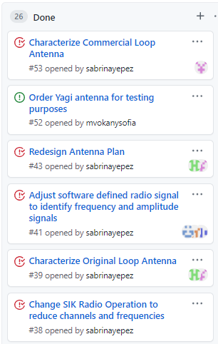
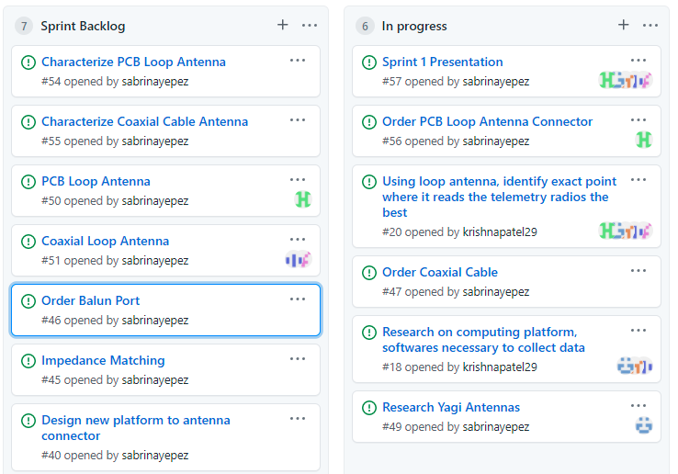
Scrum Board Overview

Slide 5
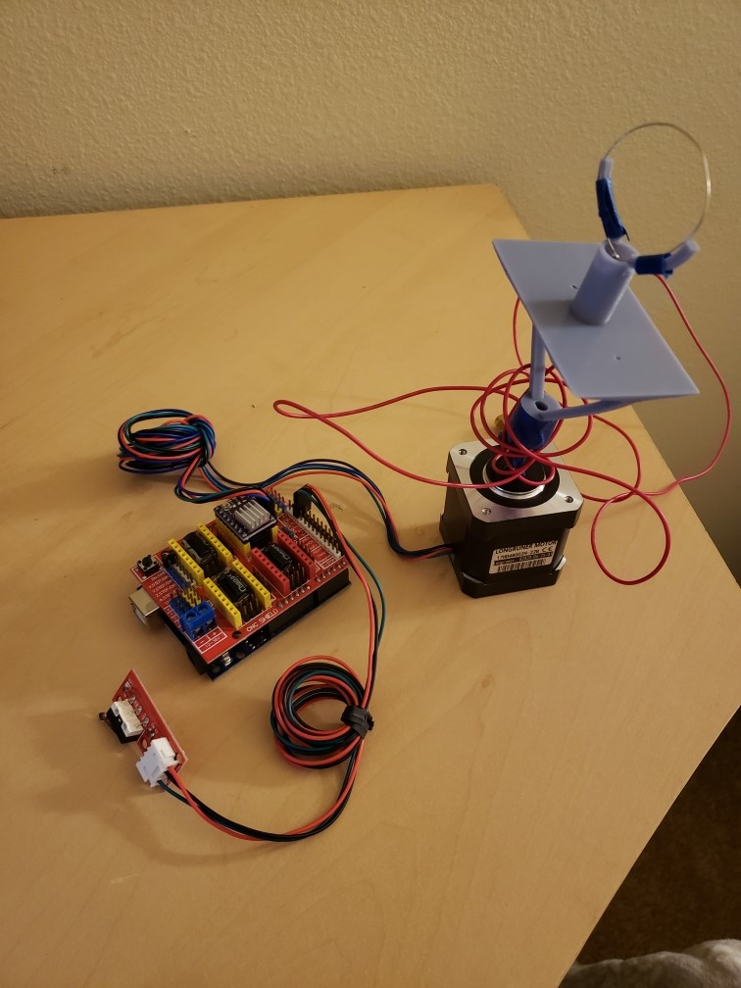
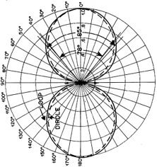
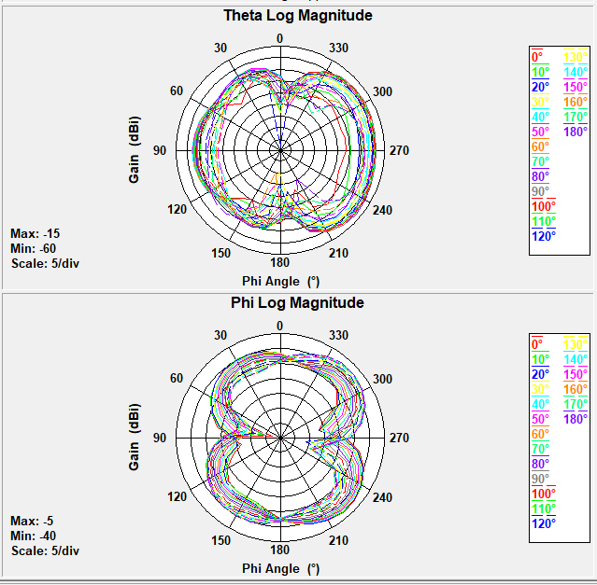
Manufactured Antenna Characterization
Phi is the horizontal axis
Theta is the vertical axis (±90°)
Following the Correct Trend
Lots of Loss
Not Consistent
Unbalanced to Balanced Coupling
Exposed Wiring acting like an inductor
Skin Effect – Increased resistance

Slide 6
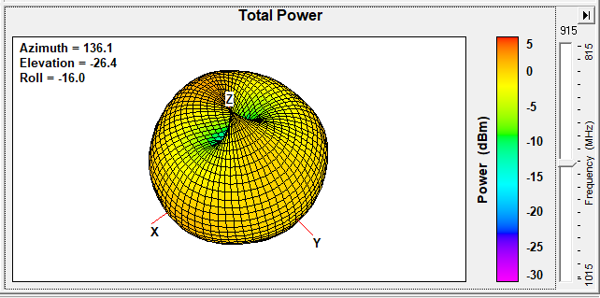
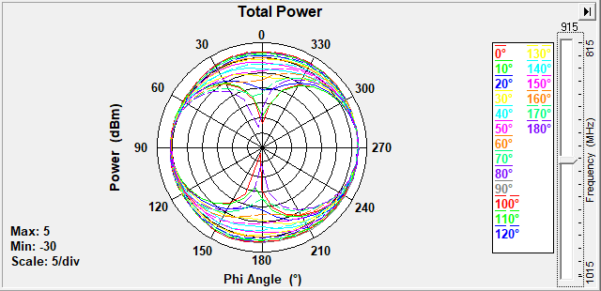
Commercial Antenna Characterization
Testing of commercial 915 MHz antenna in anechoic chamber
Exhibits slight directional dips
Less directionality likely due to electrically large size

Slide 7
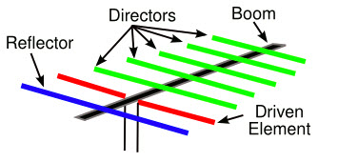
Antenna Redesign - Research
Yagi Uda antenna is a good candidate: directional antenna
Directional antenna: radiates more power in specific directions, reducing the risks of interferences and increasing the received gain.
A 900 MHz Yagi antenna can have up to 9 dBi gain compared to loop antennas that have 1 dBi peak gain.

Slide 8
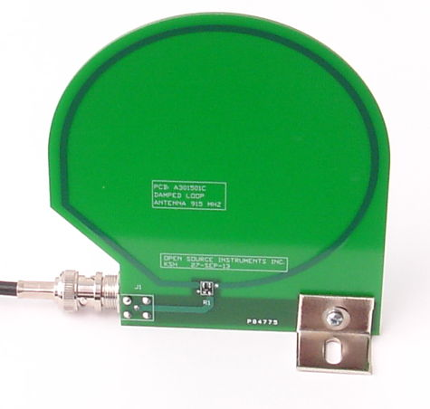
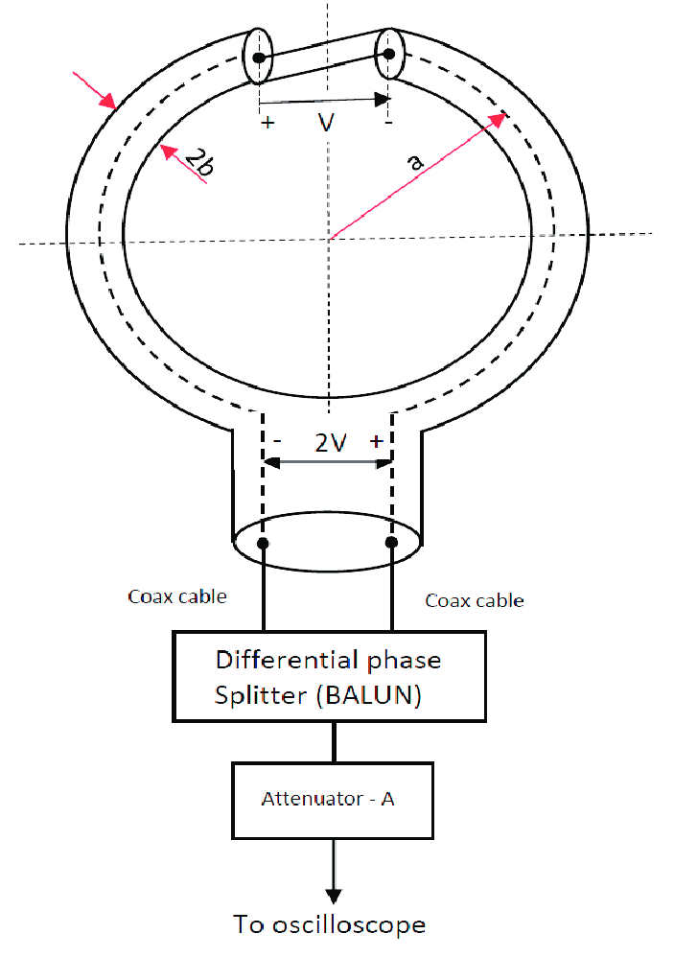
The Future – Antenna Redesign
PCB Loop Antenna
- Used the LPKF Micromachining laser in the WiDE lab to manufacture antenna
- Solder on a SMA connector
Coaxial Loop Antenna
- Will be designed and simulated in HFSS
- Manufactured with a coaxial cable
- Loop antenna connected to coaxial antenna using Balun port

Slide 9
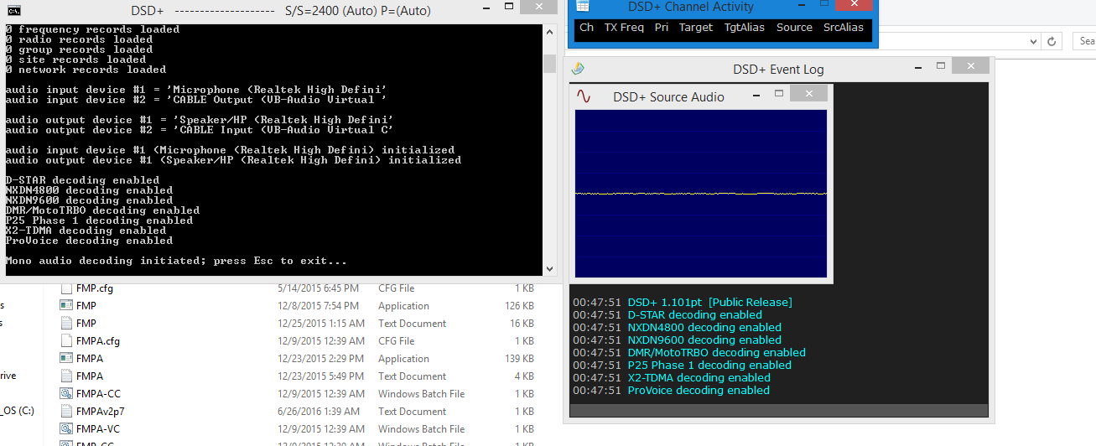
Computing Platform - Research
Currently using DSD+
Computing platform that decodes signals received by the SDR
It displays the time of interception and frequencies of the received signals as a chronological list.

Slide 10
The Future – Computing platform
- DSD+ is not optimal for the data extraction currently desired. We will continue seeking a better computing platform.
- Some possible options are Matlab, GNU radio or optimizing the graphical data collection using the Airspy display.
- The data collection is highly correlated to the used antenna

Slide 11
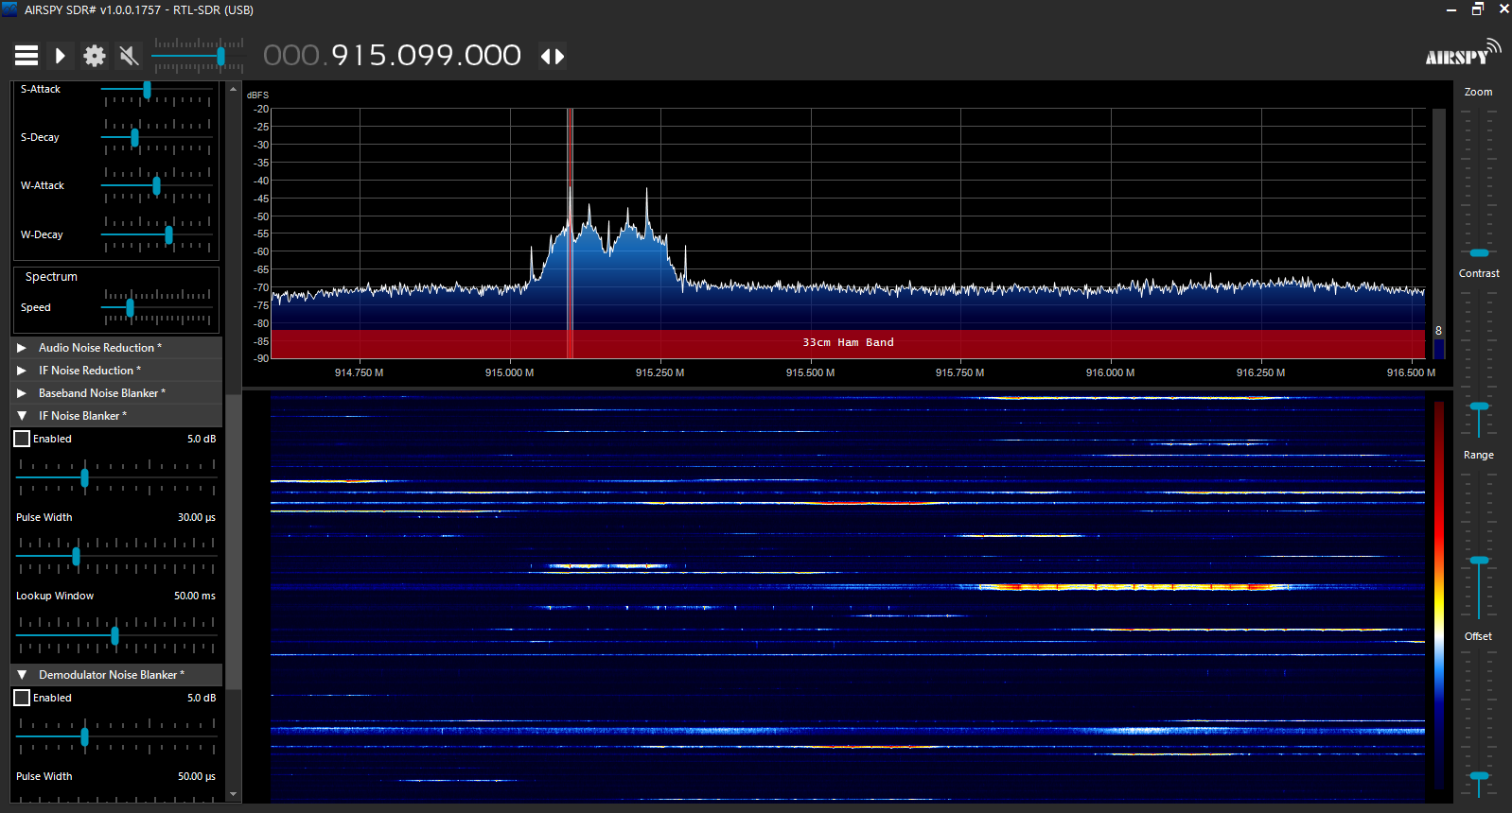
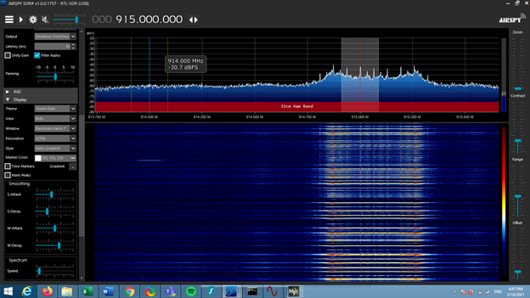
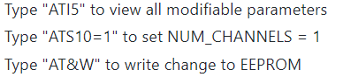
Sprint 1 Telemetry Radio Modifications:
Last semester: Radios used FHSS over 50 channels, making tracking difficult
Modified number of hopping channels using PuTTY and command-line
Radio connected via USB
Before modifying number of hopping channels
After modifying number of hopping channels

Slide 12
Questions?

Slide 13
Telemetry Radios
2 Holybro 915 MHz telemetry radios were used for this system; they operate with FHSS
Telemetry radio 1 is connected to a Pixhawk 4
Telemetry radio 2 is connected to a laptop via USB
The spectrum of data exchanged is detected using the RTL-SDR and displayed by Airspy
Before modifying number of hopping channels
After modifying number of hopping channels

Slide 14
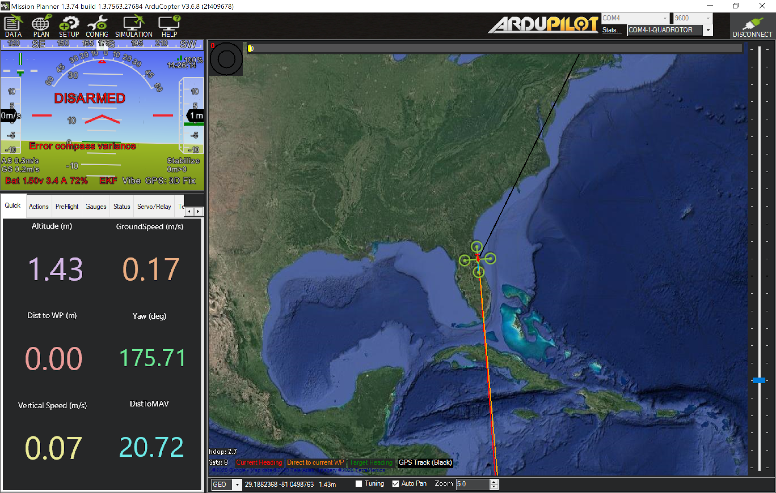
Mission Planner and GPS Configuration
The Pixhawk configuration with Telemetry radio 1 and GPS creates flight parameters with Mission Planner
Projected flight path uses location to interface in real-time
Result is a functional simulation of a drone to be tracked by telemetry radio 2 in real-time

Slide 15
Stepping Motor
Direction
Coded the motor to be able to move clockwise and counterclockwise
Can rotate 180° or any angle specified in the code
Speed
User can control speed, exact speed wanted can be coded in.
EndStop
When the user presses the endstop switch rotation will stop, when the switch is let go the the rotation will start again.
Angle
Will output the angle every 10 degrees
Can accurately count in full 360 or the 180 that we use
Starts and stops with endstop switch

